Slide 1

PREDICTIVE GRID RESILIENCE
GridGuard AI
Intelligent Grid Failure & Outage Prevention Across Generation, Transmission, Substations & Distribution
SEPTEMBER 15, 2026

Slide 2
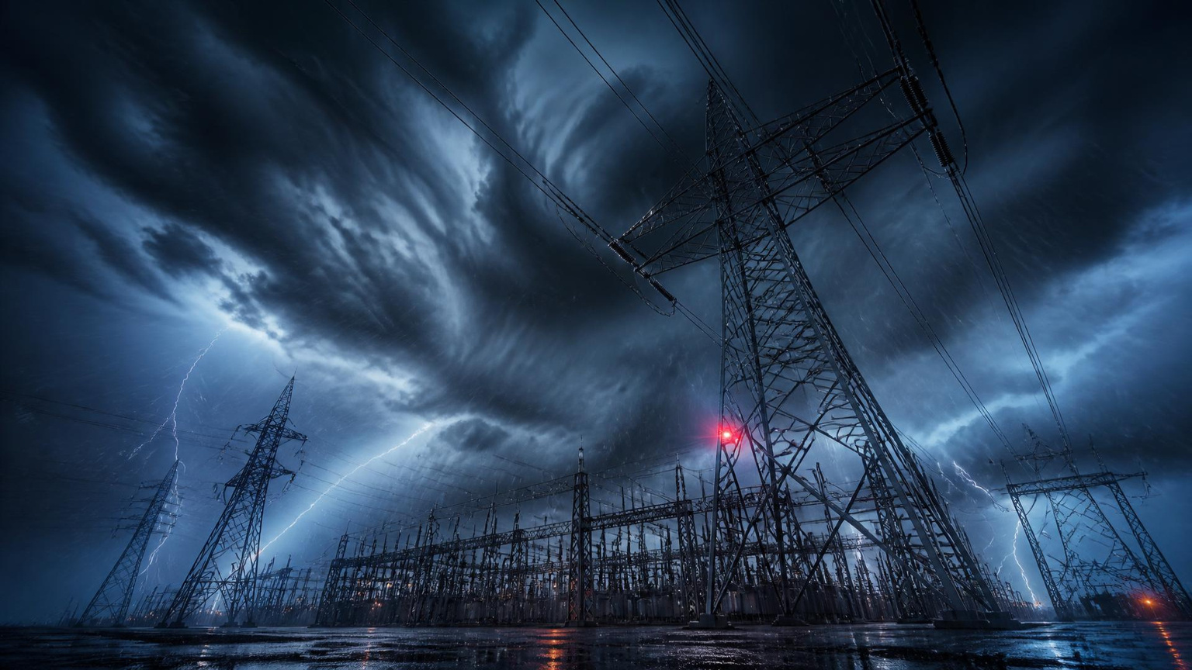
02 / GRIDGUARD AI · THE CHALLENGE
Prevent failures before they happen.
Transmission lines and substations face increasing failure risk due to aging assets and extreme weather.
30%
of outages are caused by preventable equipment failures aggravated by weather.
FROM REACTIVE RESTORATION → PREDICTIVE PREVENTION
GRIDGUARD AI • PREDICT / PRIORITIZE / PREVENT 02

Slide 3
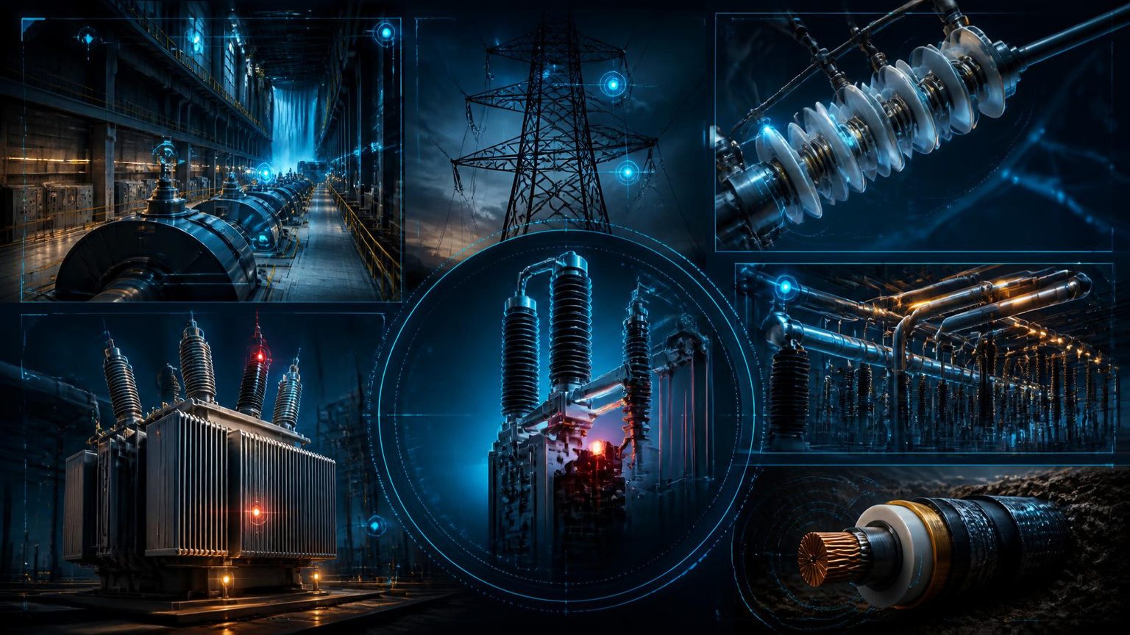
03 / GRIDGUARD AI · COMPREHENSIVE COVERAGE
One intelligence layer. Every critical asset.
GENERATION
Generators · step-up transformers
TRANSMISSION
Towers · lines · insulators · breakers
SUBSTATIONS
Transformers · busbars · switchgear
DISTRIBUTION
Feeders · cables · field equipment
GRIDGUARD AI • PREDICT / PRIORITIZE / PREVENT 03

Slide 4
04 / GRIDGUARD AI · REAL-TIME + FORECAST
Line L-204 / risk is already at 84%.
HIGH LOADING · RISING CONDUCTOR TEMP · EXTREME HEAT · STRONG WIND · PRIOR FAULTS
84%
OVERALL RISK
2 substations affected
15 MW load
12,000 consumers
RECOMMENDED ACTION
Inspect towers + insulators before storm. Prepare alternate power flow.
GRIDGUARD AI • PREDICT / PRIORITIZE / PREVENT 04

Slide 5
05 / GRIDGUARD AI · STRUCTURAL HEALTH
Tower T-108 / structural risk 82%.
TILT
2.8°
LIVE TOWER DIGITAL MODEL
T-108
VIBRATION
HIGH
CORROSION
34%
WIND FORECAST
92 km/h
FOUNDATION
WATCH
AI RECOMMENDATION
Inspect critical members before the high-wind event.
GRIDGUARD AI • PREDICT / PRIORITIZE / PREVENT 05

Slide 6

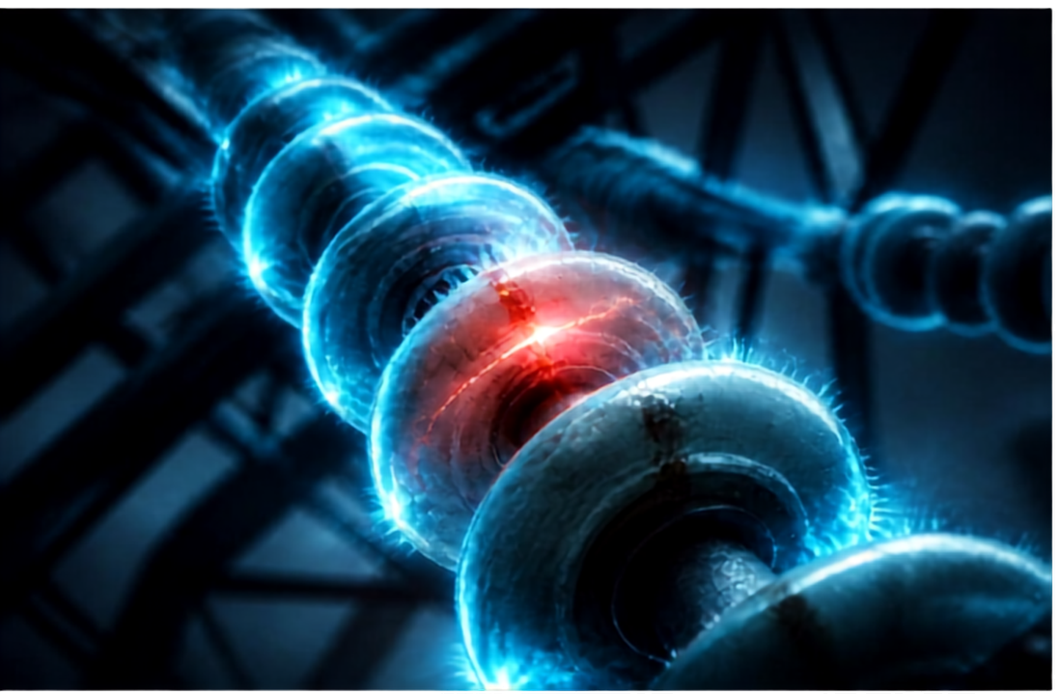



06 / GRIDGUARD AI • INSULATOR 1-45
Flashover risk is visible before failure.
79%
FLASHOVER RISK
DUST + SALT
HUMIDITY
LEAKAGE CURRENT
RAIN + CRACKING
CLEAN BEFORE SEVERE WEATHER
GRIDGUARD AI • PREDICT / PRIORITIZE / PREVENT
06

Slide 7
07 / GRIDGUARD AI · CONDUCTOR SAFETY
Forecast heat. Predict sag. Protect clearance.
94°C
CLEARANCE RISK FLAGGED
5.6 m SAG
CONDUCTOR TEMP 82%
SAG 71%
CLEARANCE 64%
WEATHER 89%
OVERALL 84%
GRIDGUARD AI • PREDICT / PRIORITIZE / PREVENT 07

Slide 8
08 / GRIDGUARD AI · WEATHER RISK ENGINE
Weather becomes asset-specific intelligence.
LIGHTNING
Arresters · insulators · trips
HIGH WIND
Tower stress · swing · trees
EXTREME HEAT
Conductor sag · transformer load
WIND · RAIN · LIGHTNING · HEAT
GRIDGUARD AI • PREDICT / PRIORITIZE / PREVENT 08

Slide 9
09 / GRIDGUARD AI · IMPACT ANALYSIS
A digital twin sees the cascade.
GENERATOR
LINE L1
SUBSTATION
FEEDERS
TOWER T1
TOWER T2
TRANSFORMER
FAILURE ORIGIN
GridGuard AI calculates downstream load, customers and restoration options before operators act.
GRIDGUARD AI • PREDICT / PRIORITIZE / PREVENT 09

Slide 10
10 / GRIDGUARD AI · AI PIPELINE
Signals in. Decisions out.
SCADA + SENSORS
WEATHER · FAULTS
FAILURE
PREDICTION
OPERATOR
COPILOT
ANOMALY
DETECTION
RISK
SCORING
MAINTENANCE PRIORITY · CREW POSITIONING · SPARE PARTS PLANNING
GRIDGUARD AI • PREDICT / PRIORITIZE / PREVENT 10

Slide 11

11 / GRIDGUARD AI · RISK HEATMAP
The signature view: one live grid risk map.
CRITICAL ZONE 3
L-204 84%
T-108 82%
S-4 71%
STORM IN 8 HOURS
Pre-position crew. Inspect critical assets.
LOW MODERATE HIGH CRITICAL
GRIDGUARD AI • PREDICT / PRIORITIZE / PREVENT 11

Slide 12
GRIDGUARD AI
Predictive intelligence.
A more resilient grid.
LET’S TRANSFORM GRID RESILIENCE TOGETHER
HACKATHON 2026 · TEAM GRIDGUARD

